Slide 1
Business Process Engineering
KAIZEN Method

Slide 2
What is Kaizen?
A kanji word – made up of KAI & ZEN
KAI means change & ZEN means for the better
This KAIZEN means Change for the Better and implies Continuous Improvements in all areas and at all levels
It implies a continuous improvement in all company functions, and at all levels

Slide 3
The wider meaning is continuous improvements, done consistently, at every time, every step, every place, leading to self development
This in turn influences the neighbourhood development, not only at the company level, but also the society at all three levels that one plays – such as produced, consumer and a good social being

Slide 4
History
Modern Kaizen is based on the principles of the Toyota Production System (TPS).
TPS is a system used in repetitive manufacturing, but the philosophy can be applied to all operations.

Slide 5
Why Kaizen?
Change is the only permanent solution
Change is required to meet the challenges of changing needs of customers
Person close to the hob knows best about the job
Enhances the price of people

Slide 6
3 Pillars of KAIZEN
Housekeeping
Waste Elimination
Standardization

Slide 7
Kaizen’s Pillars – 1. Housekeeping with 5S
5S Framework
Sort
Straighten
Shine
Standardize
Sustain

Slide 8
Kaizen’s Pillars – 1. Housekeeping with 5S
5S is a process for implementing and maintaining a clean, safe, and organized work area.
5S provides a way for organizations to operate efficiently and effectively.
5S is a Lean Organization tool that helps build a foundation for continuous improvement.

Slide 9
Kaizen’s Pillars – 1. Housekeeping with 5S
American Standard 5S | Japanese 5S | Translation
Sort | Seiri | Put things in order
Straighten | Seiton | Proper Arrangement
Shine | Seiso | Clean
Standardize | Seiketsu | Purity
Sustain | Shitsuke | Commitment

Slide 10
Kaizen’s Pillars – 1. Housekeeping with 5S
Sort - Define what is and isn’t needed in the area to do the job. Remove items not needed: tools, books, instructions – prioritize essential items
Set in Order - Organize the work area based on ‘A place for everything and everything in its place.’ Designate locations for files, tools, equipment, supplies, etc. and label properly
Shine - Clean, sweep, scrub, etc. \
Standardize - Identify “Best Practices” and document them so they can be followed by everyone. Use same tools, processes, and documentation where applicable.
Sustain – Maintain and review with everyone involved. Continual reinforcement of the importance of 5S; Audits, Culture change – make it a habit.

Slide 11
Kaizen’s Pillars – 1. Housekeeping with 5S
Sort
Remove non-essential items from work area
Sort through desk drawers, file cabinets, carts, tables, office supplies, materials, paper work, and discard unneeded items
Remove hardcopy items where not needed
Sort computer files the same as hardcopy files – remove outdated and unused folders

Slide 12
Kaizen’s Pillars – 1. Housekeeping with 5S
Set In Order
Replace files and folders in a more organized manner
Organize by removing waste in the processes; reduce movement and transportation
Label files, drawers, cabinets, shelves, etc. Label office equipment in common areas.
When labeling, ask the question “Could someone find these items if I’m not here?” If not, label it.
Use color coding to make it easier to locate and store similar information.

Slide 13
Kaizen’s Pillars – 1. Housekeeping with 5S
Shine
Clean, dust, and mop to show off your work area
Dirt, dust and clutter can have an adverse effect on quality, safety, and morale - clean everything.
Clean work environments leave customers with a comfortable feeling about your quality.
Any necessary repairs should be noted and fixed on the spot

Slide 14
Kaizen’s Pillars – 1. Housekeeping with 5S
Standardize
Define and document best practices for accomplishing the tasks in the area. Eliminate waste in tasks and processes.
Train everyone to the best practices

Slide 15
Kaizen’s Pillars – 1. Housekeeping with 5S
Sustain
Make 5S a daily part of standard work
Define tasks needed to maintain 5S. Implement daily and weekly assignment sheets to insure tasks are completed.
Set up auditing to ensure ongoing use

Slide 16
Kaizen’s Pillars – 2. Waste Elimination
8 Wastes
Defects
Overproduction
Waiting
Nonutilized Talent
Transportation
Inventory
Motion
Extra Processing

Slide 17
Kaizen’s Pillars – 2. Waste Elimination
Transportation
Definition
Unnecessary movement of items between processes
Causes
Poor layout and/or process Design & Planning
Unstructured or not understood Value Stream
Complex Material flow
Problems
Increased Time & Cost to transport & search
Increased Defects due to accidents

Slide 18
Kaizen’s Pillars – 2. Waste Elimination
Inventory
Definition
Any raw material, Work in Progress (WIP) or finished goods which are being stored
Causes
Overproduction causes inventory build up between processes
Problems
Adds cost
Requires space
Hides process defects
Can become a defect

Slide 19
Kaizen’s Pillars – 2. Waste Elimination
Motion
Definition
Unnecessary movement within a Process
Causes
Poor workplace layout
Poor process planning
Poor Housekeeping
No Standard Operating Procedures
Problems
Adds time & cost
Can be safety issue

Slide 20
Kaizen’s Pillars – 2. Waste Elimination
Waiting
Definition
Unnecessary movement within a Process
Causes
Poor workplace layout
Poor process planning
Poor Housekeeping
No Standard Operating Procedures
Problems
Adds time & cost
Can be safety issue

Slide 21
Kaizen’s Pillars – 2. Waste Elimination
Over Processing
Definition
Processing beyond the value required by the Customer
Causes
Lack of Customer Focus
“Always done it this way”
Lack of understanding
Scheduled work time is longer than needed
Problems
Increases time & cost

Slide 22
Kaizen’s Pillars – 2. Waste Elimination
Over Production
Definition
To produce items sooner or in greater quantities than required for customer demand
Causes
Poor planning
Incorrect bottleneck assumptions
Problems
Overproduction discourages a smooth flow of production
Leads to excessive work in process inventory

Slide 23
Kaizen’s Pillars – 2. Waste Elimination
Underutilized People
Definition
Underutilization of people’s Abilities, Knowledge, and Skills
Causes
Constant management turnover unaware of talent pool
Employee not happy in current position
Problems
Great ideas might be missed
Dominant personalities may force focus in wrong direction

Slide 24
Kaizen’s Pillars – 2. Waste Elimination
Defects
Definition
A defect is when the Customer believes they did not get what they paid for
Causes
Process Variation
Customer requirements not understood
Problems
Additional Time & Cost
Reduces Customer Confidence

Slide 25
Kaizen’s Pillars – 3. Standardization
It helps to reduce variation
It is set by management but able to change when the environment changes.
It is a never-ending process and is better explained and presented by the PDCA
It is a repeated process followed by team!!!

Slide 26
Kaizen’s Pillars – 3. Standardization
Do
Check
Plan
Act

Slide 27
Kaizen’s Pillars – 3. Standardization
It helps to reduce variation
It is set by management but able to change when the environment changes.
It is a never-ending process and is better explained and presented by the PDCA
It is a repeated process followed by team!!!

Slide 28
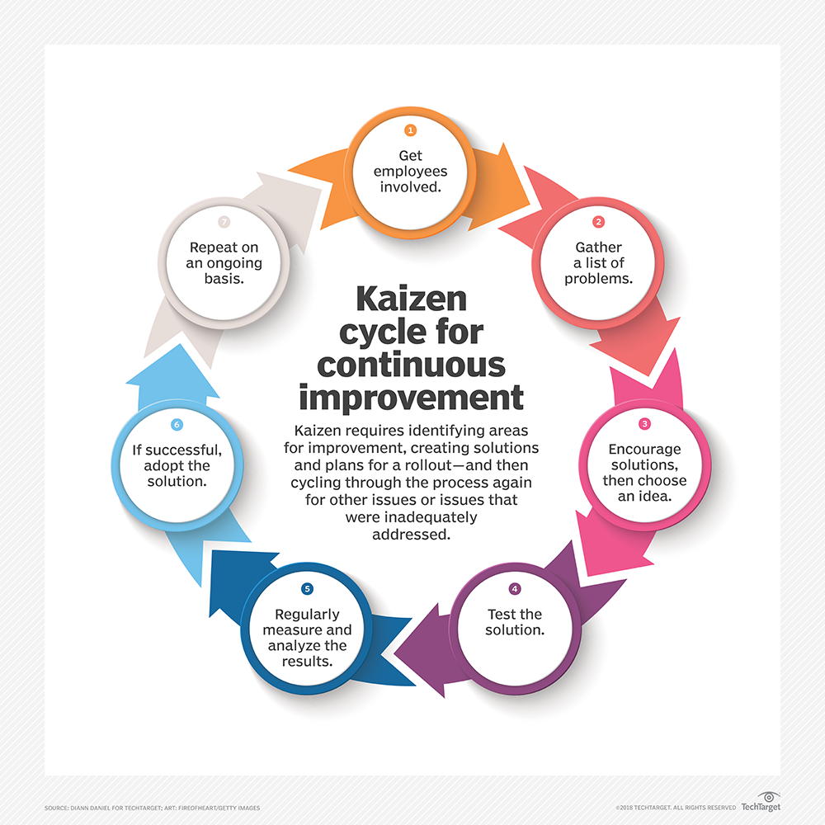
How KAIZEN Works

